Slide 1
Synchronous vs Asynchronous
Programming Palli

Slide 2
Synchronous
Synchronous is a blocking architecture, the program execution is blocked until the current task is complete, and the program cannot move on to the next task until the current one is finished.

Slide 3
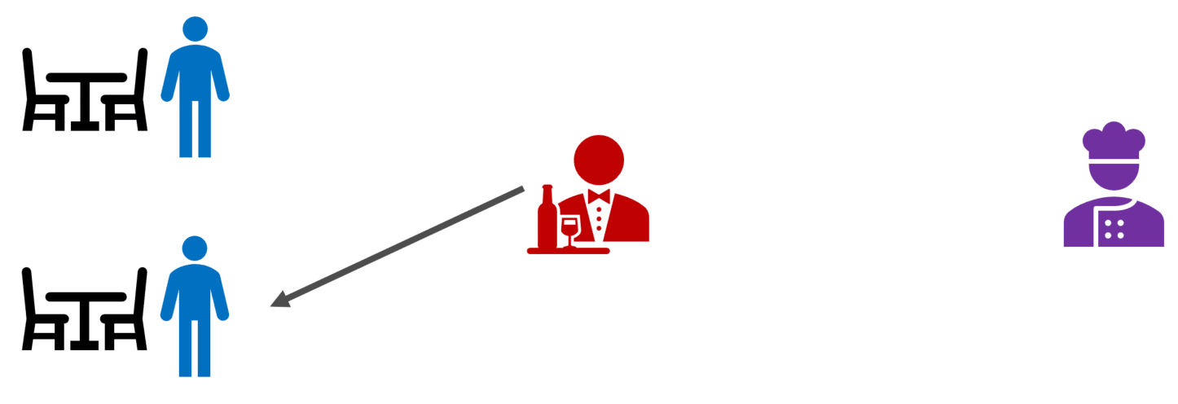
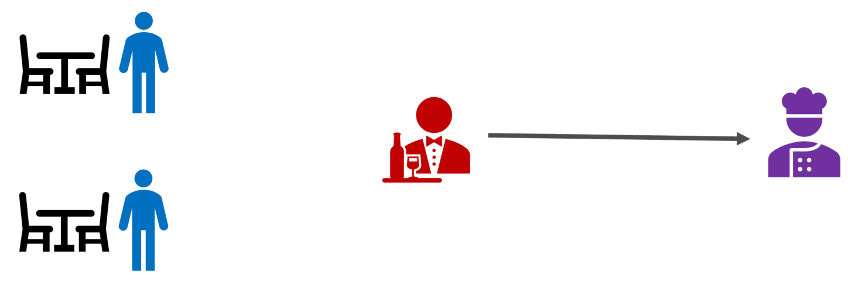
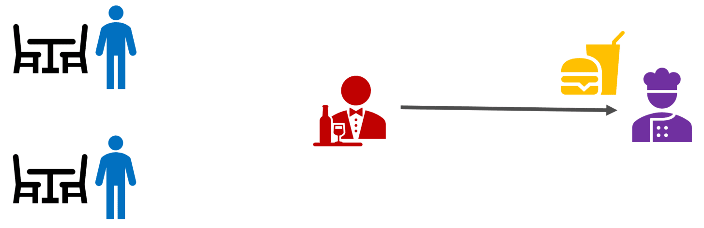
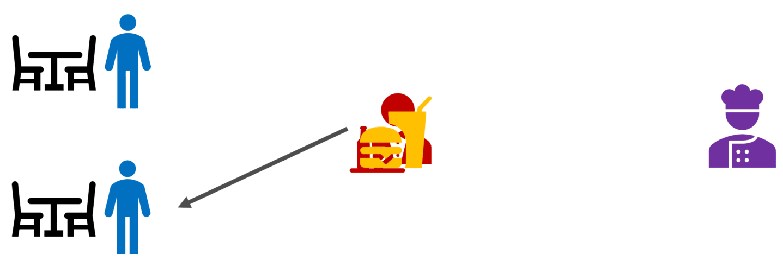
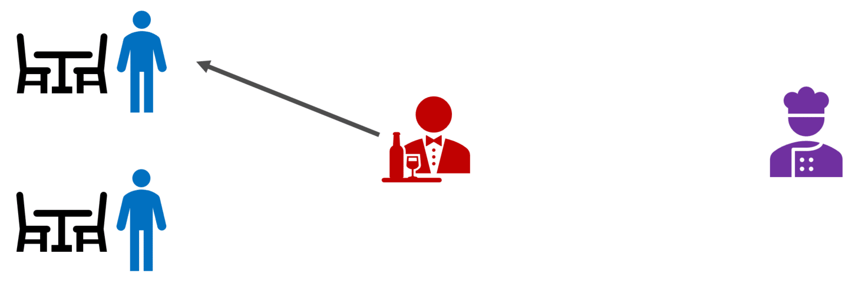
Synchronous Example
1. Order Request
2. Order Confirm
3. Food Ready
4. Food Delivered
4. Another Order Request

Slide 4
Pros
Synchronous programming is straightforward and easy to understand.
It executes tasks sequentially, making it easier to debug.
Simplicity.
Especially for small, simple tasks.

Slide 5
Cons
The program will not be able to handle multiple tasks concurrently.
Less responsive user interface.
Time-consuming tasks.
Scalability issues.

Slide 6
Asynchronous
Asynchronous is a non-blocking architecture, so the execution of one task isn’t dependent on another. Tasks can run simultaneously.

Slide 7
Asynchronous Example
1. Order Request
3. Order Confirm
2. Another Order Request
4. Food Ready
5. Food Delivered

Slide 8
Pros
You can use multiple features at a time, even while other requests are still running.
Asynchronous apps are highly scalable.
Maximum utilization of CPU and Memory of system.

Slide 9
Cons
Debugging not easy.

Slide 10
Thank You
Please subscribe

